Slide 1
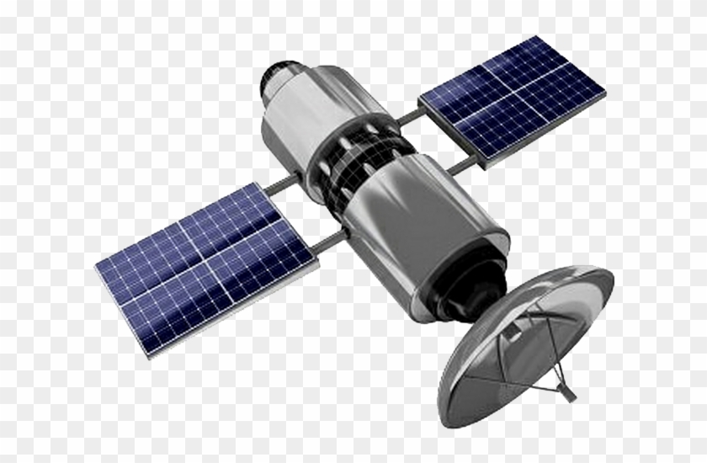
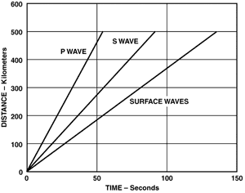




GPS-enabled data communication
Earthquake produced by ruptured fault transmits P-waves, felt first, followed by S-waves, and finally surface waves
Early Mass-Notification
Earthquake detection center used as communication medium
Fault produces earthquake.
Sensors distributed around city transmit real-time data

